Slide 1
The workhouse

Slide 2
Workhouses
Workhouses first began when a law was passed in 1838 that stated workhouses were to be built to help the poor. People worked in the workhouses in exchange for shelter and food.
By August 1846, there were about 128 workhouses around the country.
When the famine occurred and especially by 1847, the workhouses were overcrowded. For example, a workhouse built in Cork originally designed for 800 people actually kept 1,800 in bad condition.

Slide 3
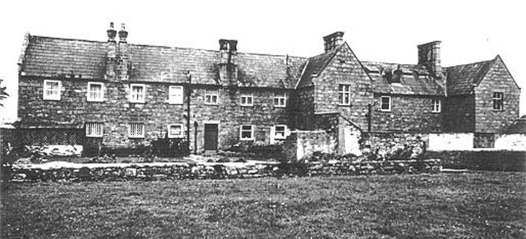
Longford workhouse

Slide 4
Entering the workhouse
Once they entered the workhouse , people had to wear a uniform and were given a very basic diet. The main food was called stirabout, this was very similar to oatmeal porridge.
When families entered the workhouse, they were split up in to men, women, boys and girls. Each lived in a different part of the building.

Slide 5
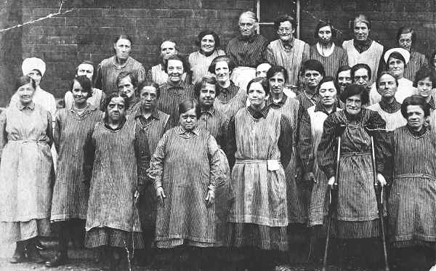
.
Do these women look happy?
Can you think of any reason for this?
What do you notice about the women in this photo?

Slide 6
Life in the workhouse
Life in the workhouse was harsh and frequently cruel. There was little to do. People were often hungry, frustrated, badly treated, bored and mostly without hope. Often the inmates reacted against this, by breaking the rules and by fighting amongst themselves. Some preferred prison to the workhouse as the food was better and the regime not as strict.

Slide 7
Sickness
People were often ill when they entered the workhouse.
This meant that many inmates died of diseases, which spread quickly in the workhouses.
The main diseases were Typhus, Cholera and dysentery.

Slide 8
Rules
There were strict rules in the workhouse such as:
Not allowed play cards
Disobey orders
Only one meal a day per person

Slide 9
Questions
Why were workhouses built?
What happened when you entered the workhouse?
What was life like in the workhouse?
What kind of rules were there in the workhouse?

